Slide 1


EXPLORATORY DATA ANALYSIS ON AIRBNB
A. Harshitha

Slide 2

INTRODUCTION
1
NAME
2
COLLEGE
A Harshitha
Vemu Institute of Technology
3
INTERNSHIP COMPANY
4
JOB ROLE
Rooman Technologies
AI Data Quality Analyst
5
EMAIL
harshithaamuru6281@gmail.com

Slide 3





ABOUT THE PROJECT
Analyze Airbnb listings in NYC to extract meaningful trends.
Focus areas: pricing, availability, room types, popular locations.
Dataset: 48,895 records from 2019 with 16 columns.
Objective: Help users make informed booking decisions and guide hosts to optimize listings.

Slide 4

BUSINESS OBJECTIVE
1
Understand listing distribution and pricing trends.
2
Identify popular and budget-friendly areas.
3
Explore how room types affect availability and price.
4
Provide data-driven insights to travelers and hosts.

Slide 5





TOOLS & TECHNOLOGIES USED
Python
Pandas, NumPy
Matplotlib, Seaborn
Jupyter Notebook
MS PowerPoint for reporting

Slide 6
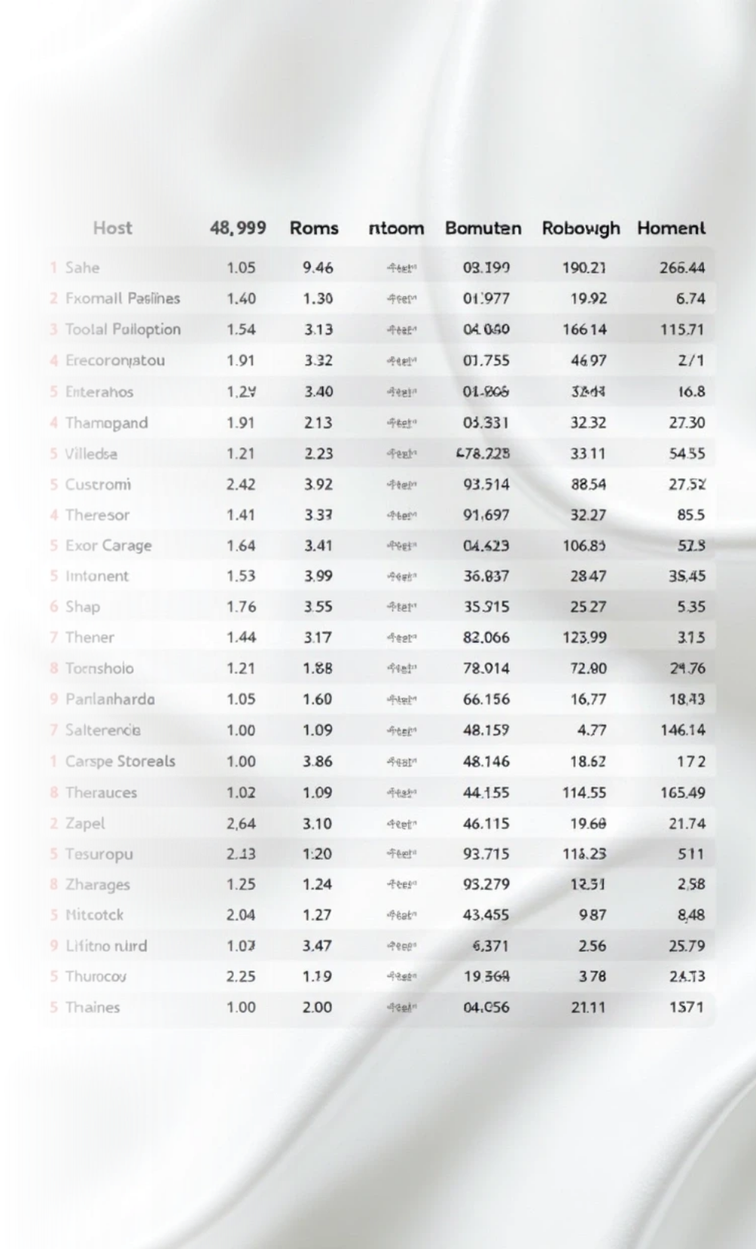
DATASET OVERVIEW
1
2
48,895 rows × 16
columns
Location info: neighbourhood, borough, coordinates
3
4
Host information and listing activity
Room details: type, price, availability, reviews

Slide 7




DATA QUALITY CHECK
Missing values in name, host_name, last_review, reviews_per_month
Outliers found in price, minimum_nights
Some columns cleaned or dropped for clarity
Dates parsed and numeric values capped for better visualization

Slide 8
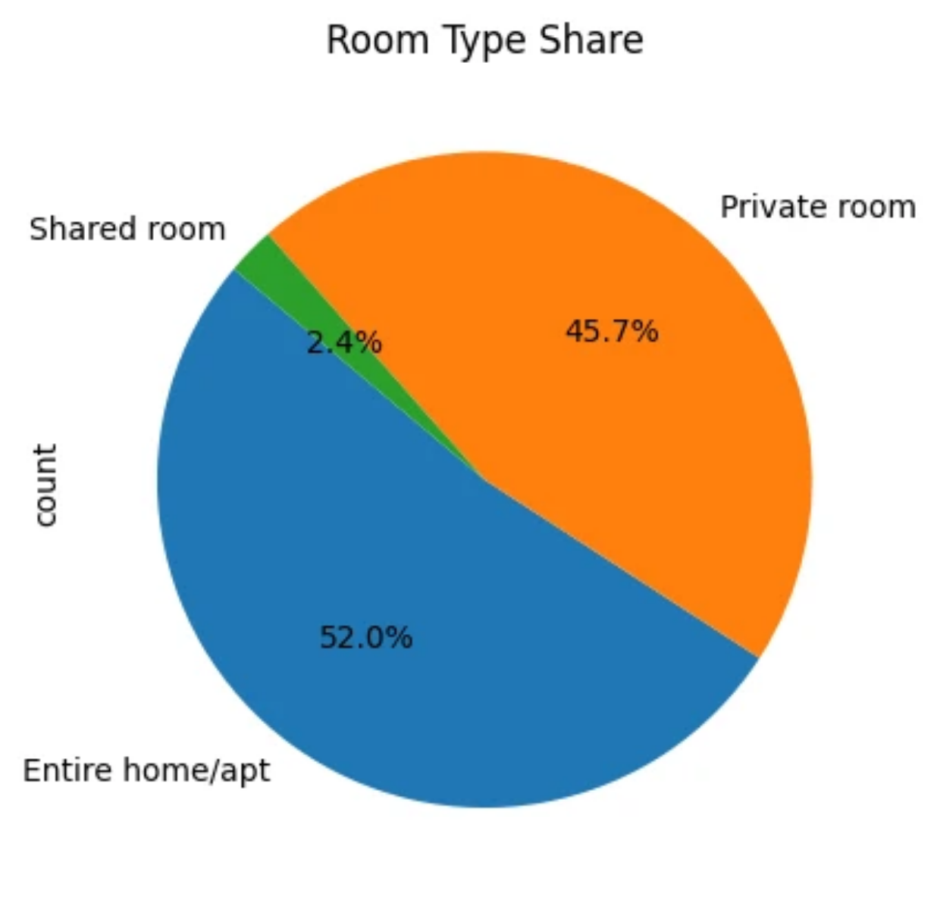
ROOM TYPE SHARE
This pie chart shows the proportion of different room types offered on Airbnb. Private rooms dominate the listings, followed by entire homes/apartments. Shared rooms account for the smallest share. This indicates that budget-conscious travelers are catered to widely. Room type selection directly affects both pricing and privacy.

Slide 9
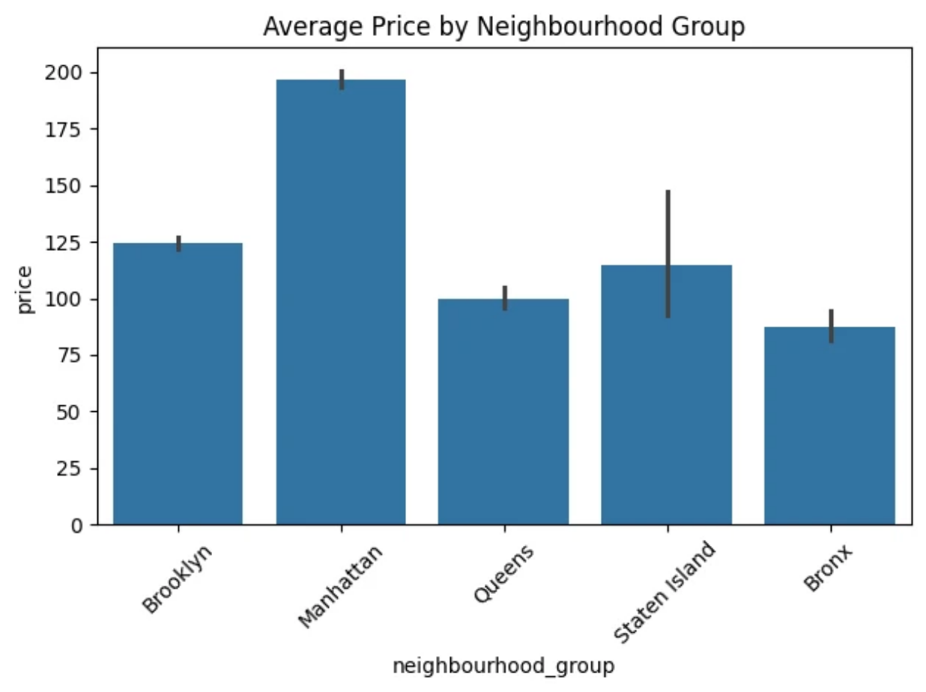
AVERAGE PRICE BY NEIGHBOURHOOD GROUP
This bar plot compares the mean price across NYC boroughs. Manhattan leads with the highest average price, confirming its premium location status. Bronx and Queens offer relatively affordable listings. The stark price difference reflects the area's tourism and demand. Travelers on a budget may prefer Brooklyn or Queens.

Slide 10
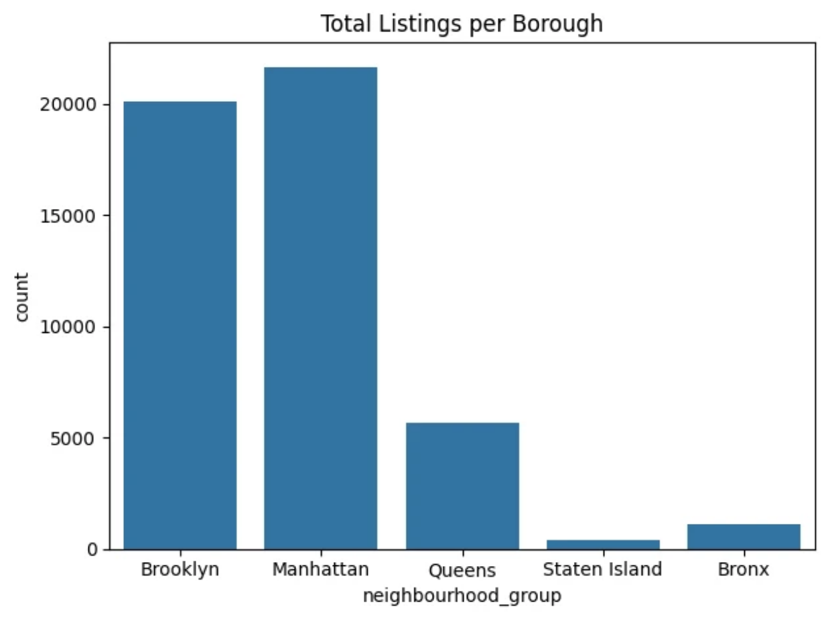
TOTAL LISTINGS PER BOROUGH
This count plot displays the number of Airbnb listings by borough. Manhattan and Brooklyn have the most listings, showing their popularity. Staten Island and Bronx have the least, possibly due to lower tourist traffic. This gives insight into where hosts are most active. Users have more options in central and tourist-heavy areas.

Slide 11
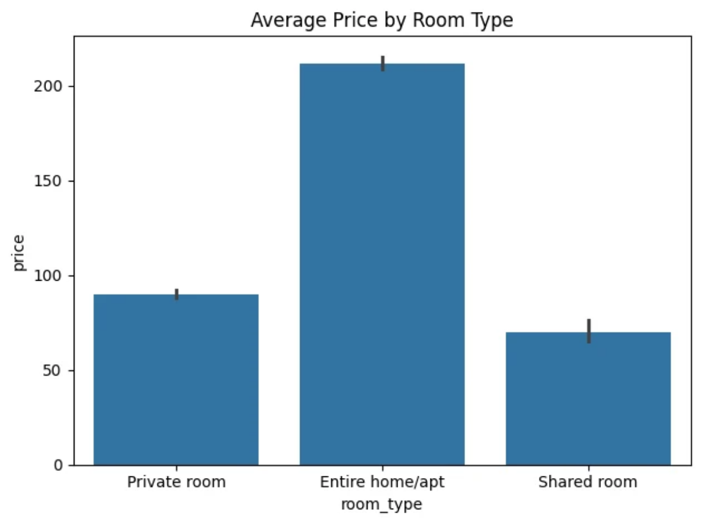
AVERAGE PRICE BY ROOM TYPE
This bar plot compares average prices for each room type. Entire homes/apartments are the most expensive, as expected. Private rooms offer a lower-cost alternative with some privacy. Shared rooms are the cheapest but less available. This helps users balance cost with privacy and comfort.

Slide 12
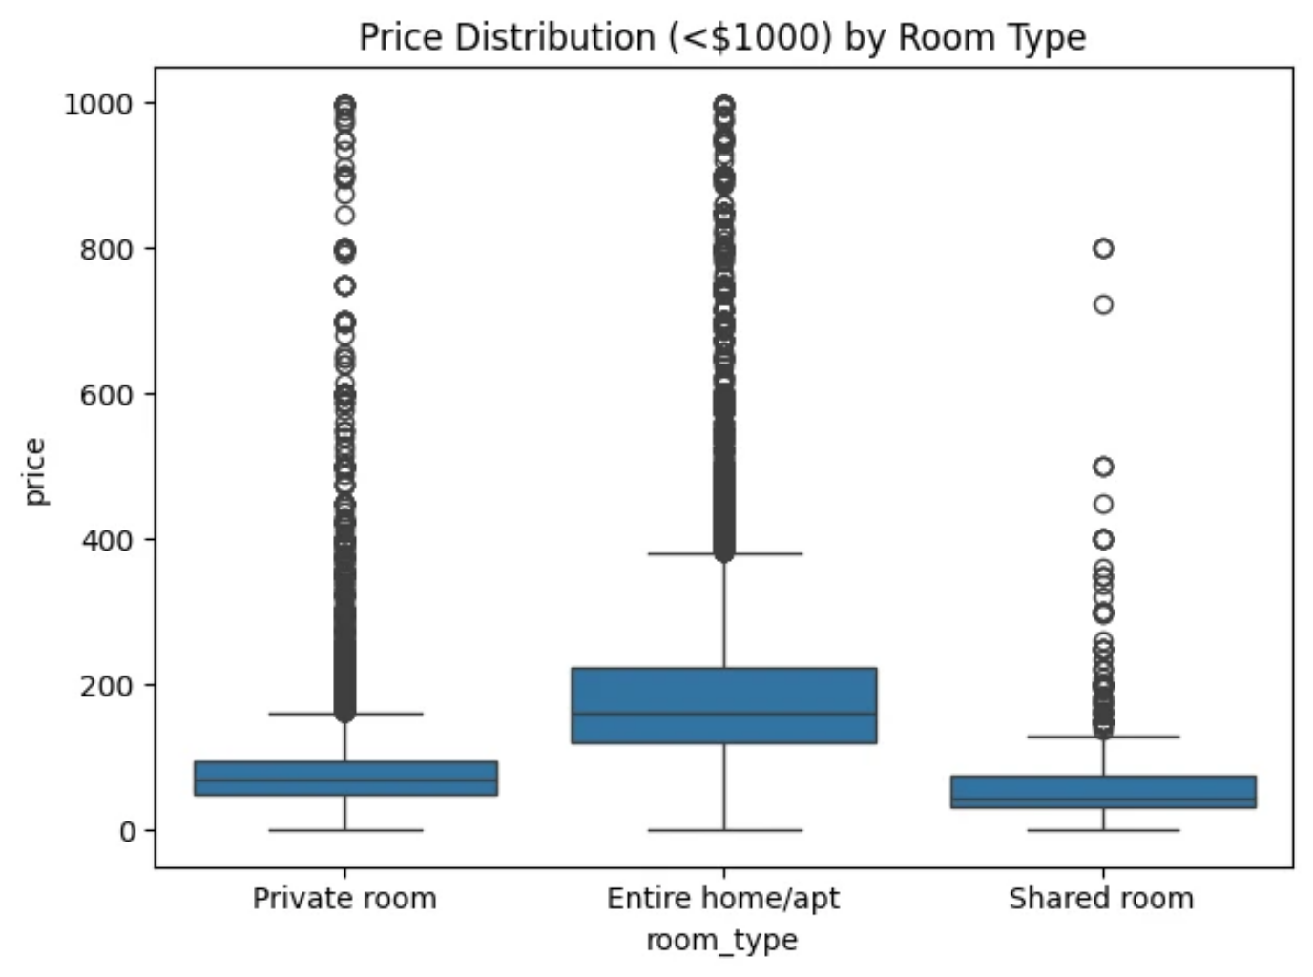
PRICE DISTRIBUTION (<$1000) BY ROOM TYPE
The box plot highlights price variation by room type, capped at $1000. Entire homes show wide price variability and higher medians. Private rooms have a tighter, lower distribution. Outliers exist in all categories, especially for luxury stays. This graph shows how much room type affects price spread.

Slide 13
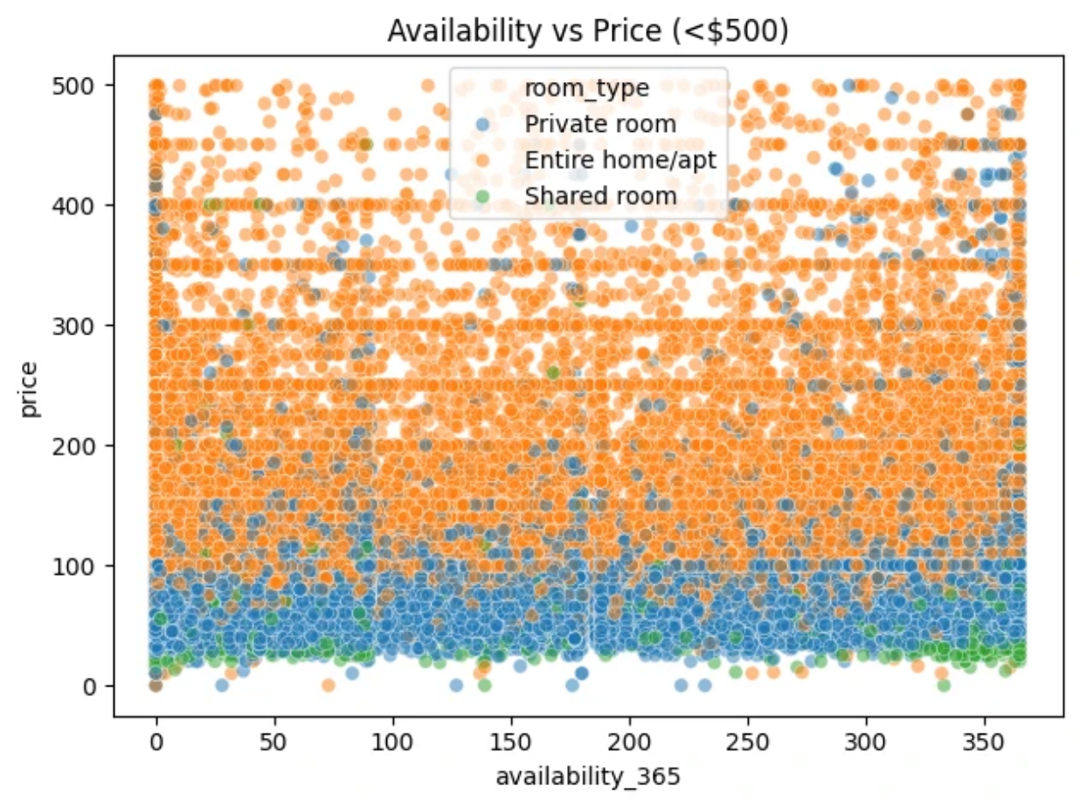
AVAILABILITY VS PRICE (<$500)
This scatter plot explores the relationship between availability and price. Listings priced under $500 are spread across various availability levels. Some lower-priced listings are available year-round, offering high value. No strong correlation between availability and price is seen. Room types are color-coded, showing all types exist across the spectrum.

Slide 14
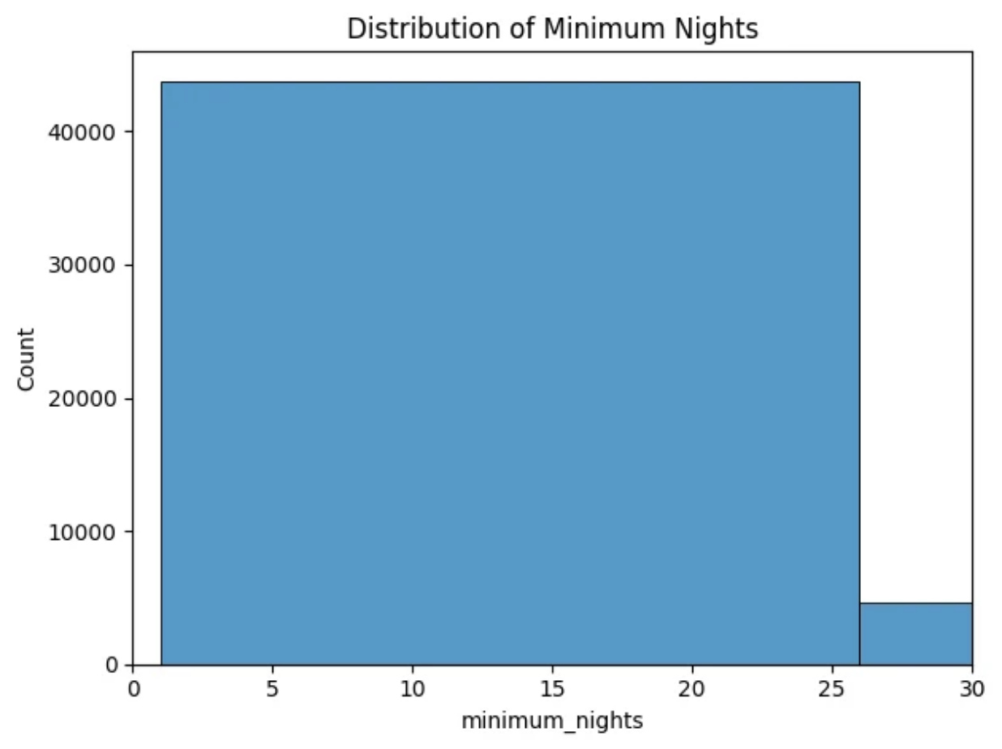
DISTRIBUTION OF MINIMUM NIGHTS
The histogram shows how many nights guests must book at minimum. The majority of listings allow 1–3 night stays, ideal for short trips. Some listings require much longer stays, though these are rare. Short minimum nights increase booking flexibility. This favors tourists who stay for weekends or quick vacations.

Slide 15
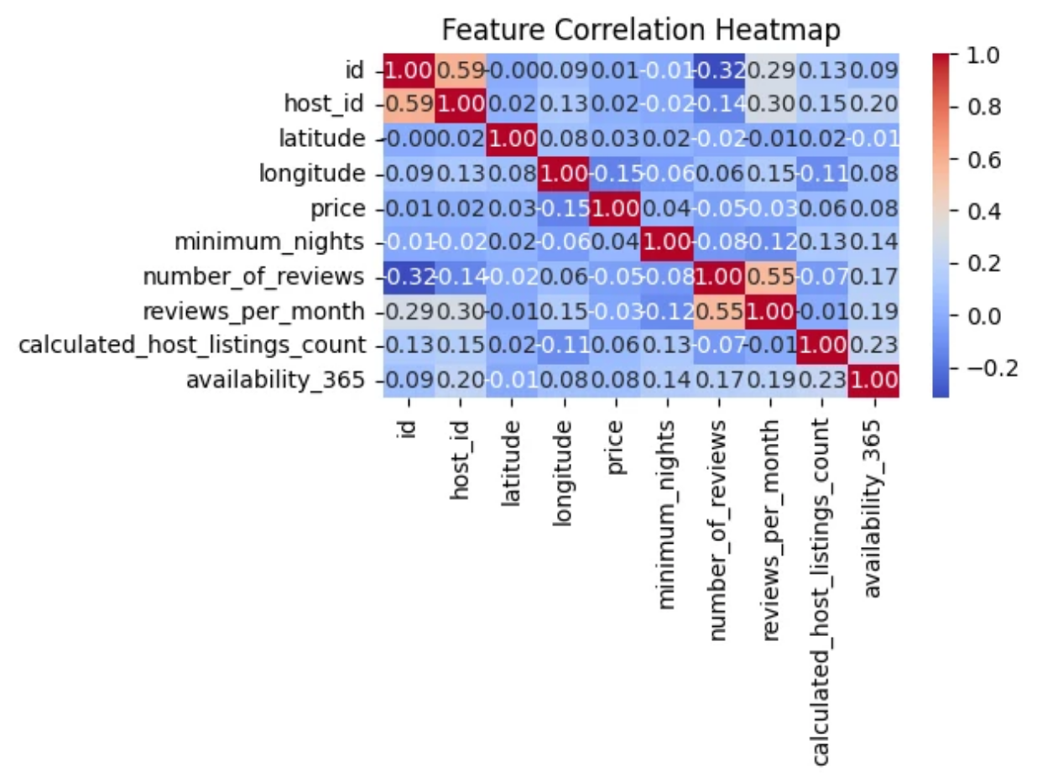
FEATURE CORRELATION HEATMAP
This heatmap visualizes correlations among numeric features. Most features show low correlation with each other. Notably, price is weakly related to reviews or availability. This implies multiple independent factors affect bookings. Useful for identifying variables for predictive modeling.

Slide 16
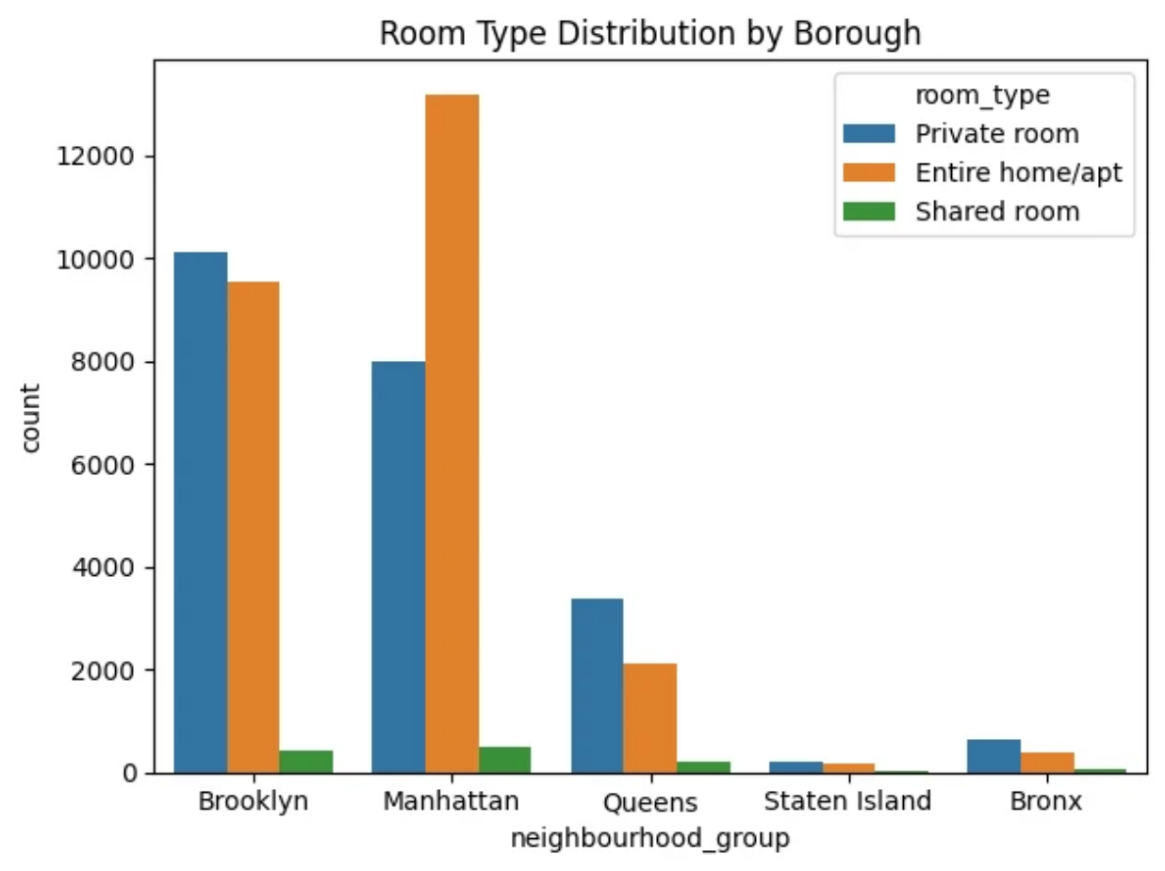
ROOM TYPE DISTRIBUTION BY BOROUGH
This plot shows room type frequency within each borough. Private rooms dominate in Brooklyn and Queens. Entire homes are more common in Manhattan. Shared rooms are scarce across all boroughs. Helps hosts align offerings with borough-specific demand.

Slide 17
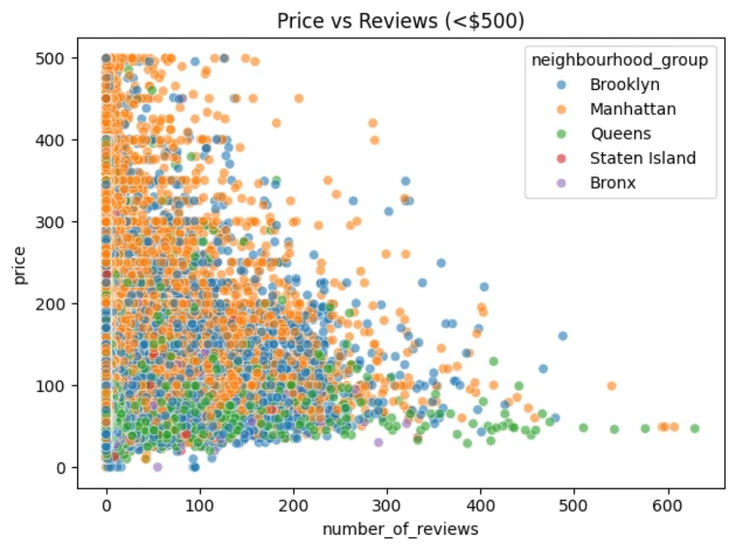
PRICE VS REVIEWS (<$500)
This graph compares price and number of reviews for listings under $500. Listings with many reviews are not necessarily high-priced. Some affordable listings have received significant customer feedback. Manhattan and Brooklyn listings cluster at higher prices. Useful for identifying high-value properties with strong reputations.

Slide 18
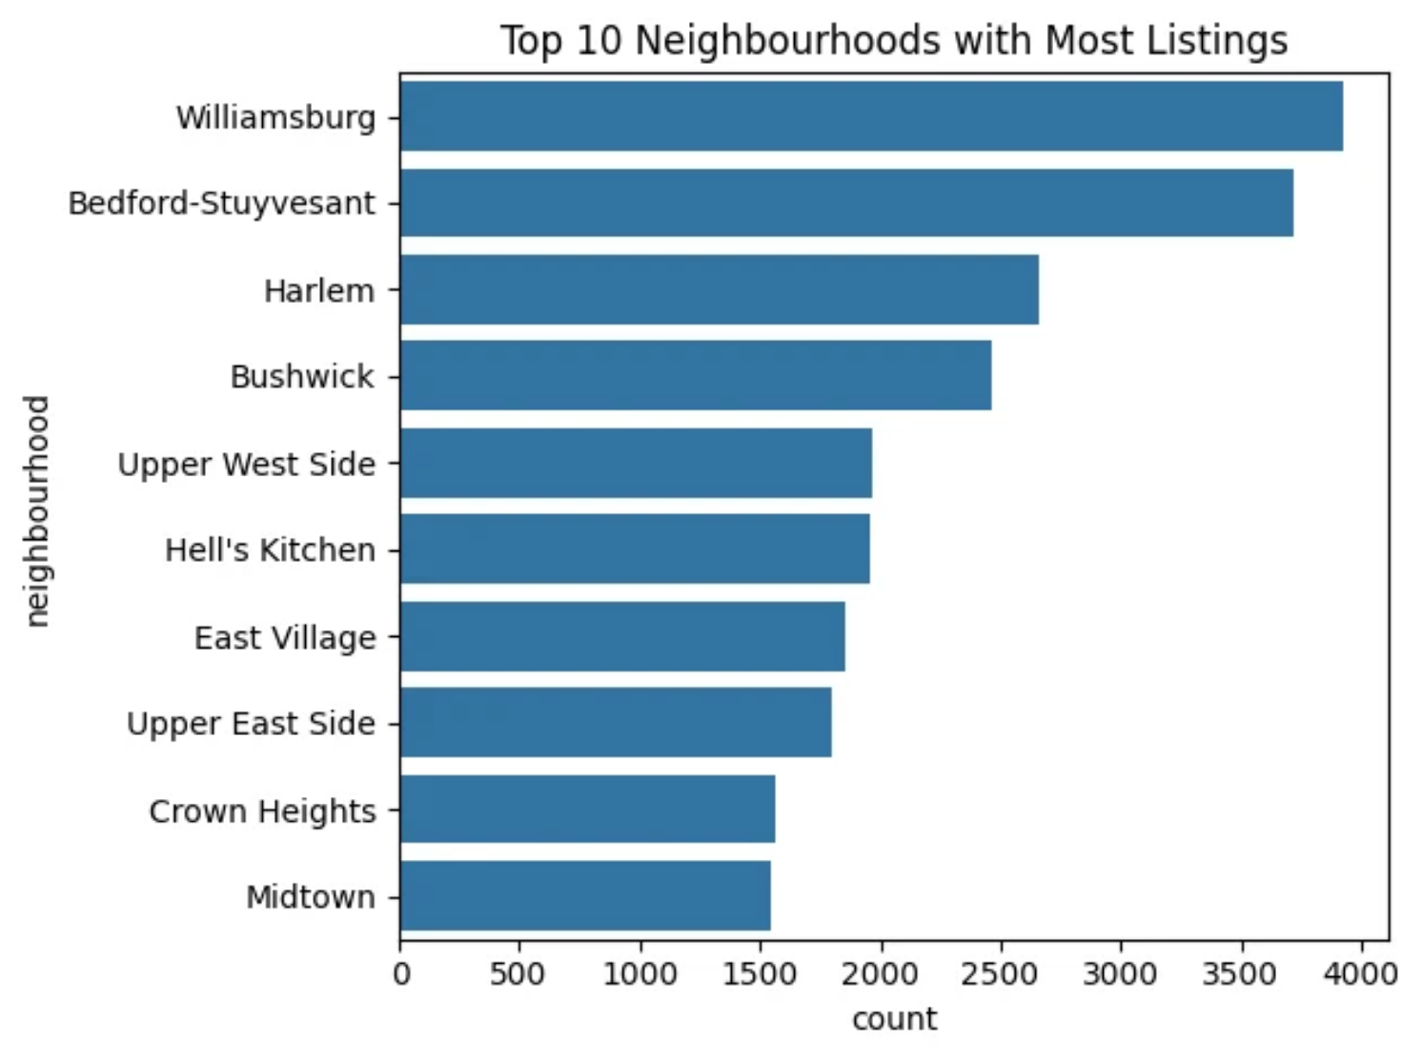
TOP 10 NEIGHBOURHOODS WITH MOST LISTINGS
This chart shows neighborhoods with the most listings. Williamsburg, Harlem, and Bedford-Stuyvesant top the list. These areas are likely Airbnb hotspots or culturally rich. High listing density means more choice and competition. A good reference for travelers and new hosts alike.

Slide 19
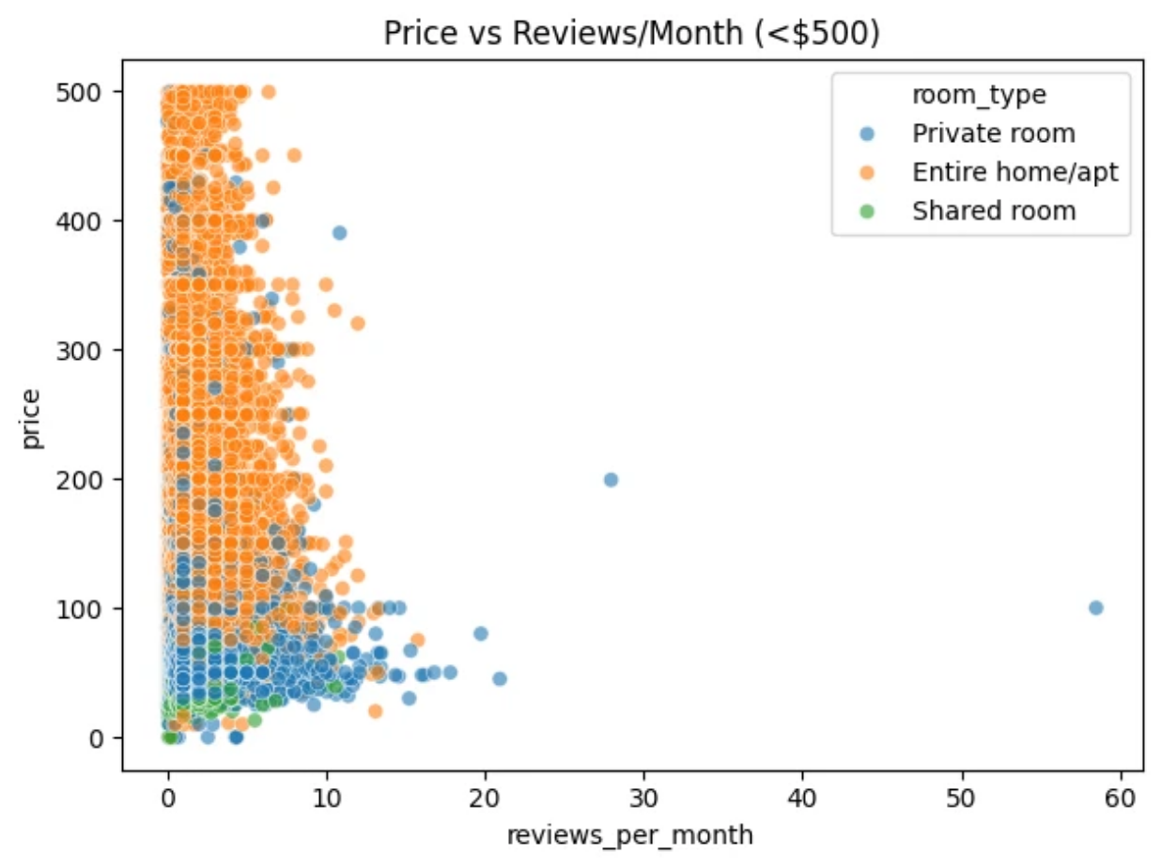
PRICE VS REVIEWS PER MONTH (<$500)
This scatter plot examines review frequency vs. price. Listings with frequent monthly reviews tend to be active and popular. However, higher price doesn’t always mean more engagement. Private rooms dominate in the high-review, low-price zone. A helpful view for travelers seeking trusted, affordable stays.

Slide 20
KEY FINDINGS
1
Manhattan is the costliest borough.
2
Private rooms are the most listed and affordable.
3
Short stays (1–3 nights) dominate the
listings.
4
Brooklyn offers a balance between price and availability.
5
High review count doesn’t necessarily mean high price.

Slide 21





CONCLUSION
Manhattan is the most expensive and heavily listed borough.
Private rooms dominate the platform and offer good value.
Brooklyn and Queens are ideal for budget-conscious travelers.
Listings with fewer minimum nights and better availability are popular.
Neighborhoods like Williamsburg and Harlem are top Airbnb hotspots.

Slide 22

THANK YOU

